Slide 1

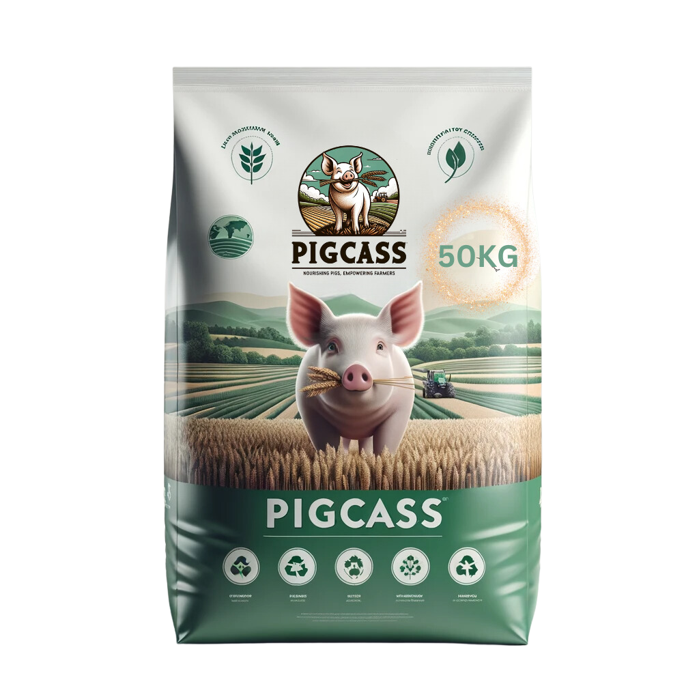
Repurposing food waste for sustainable and nutritious pig feed

Slide 2
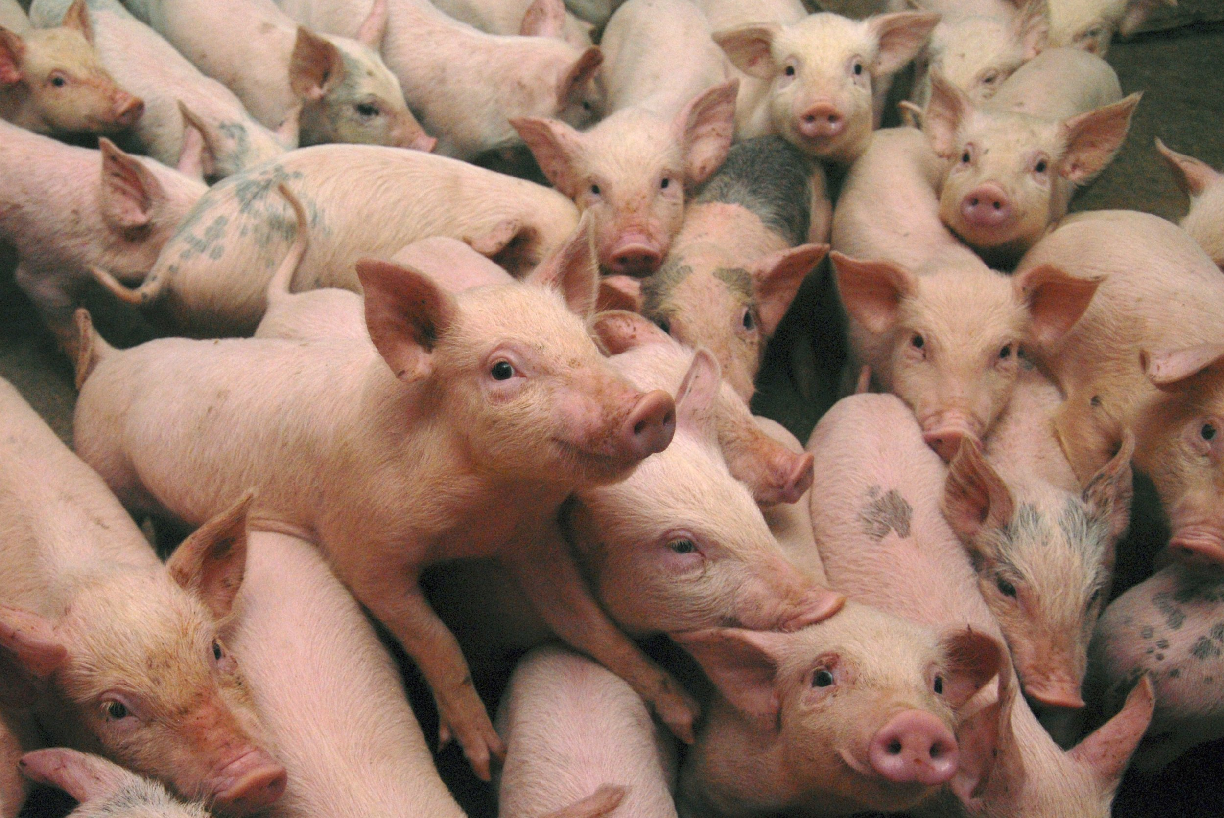
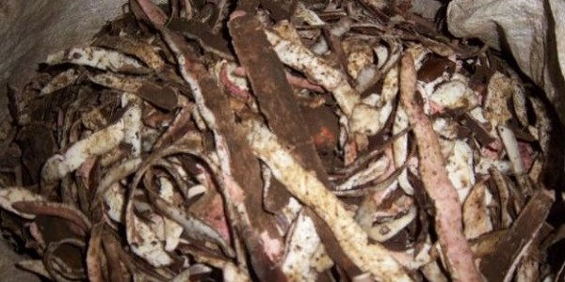
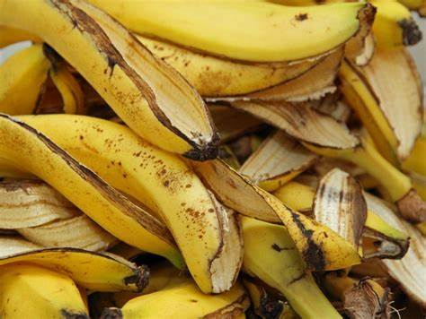
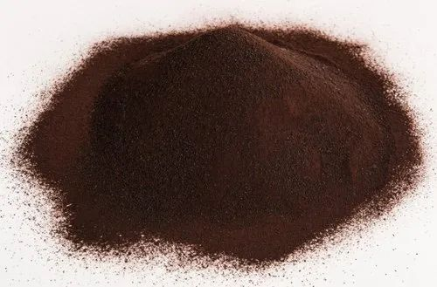
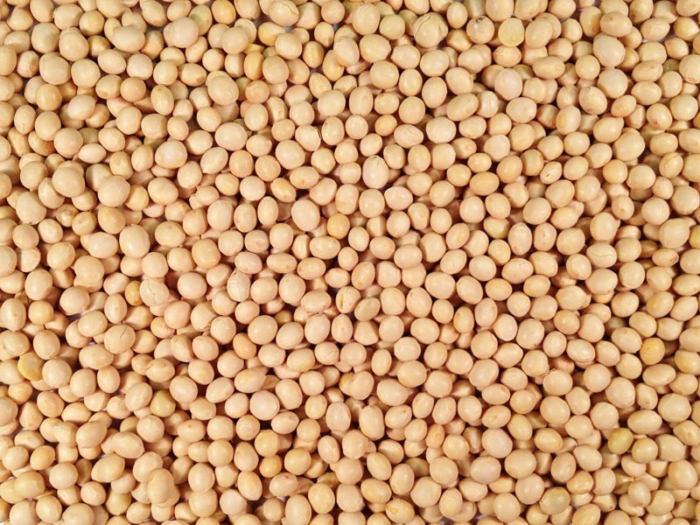
INTRODUCTION

Slide 3
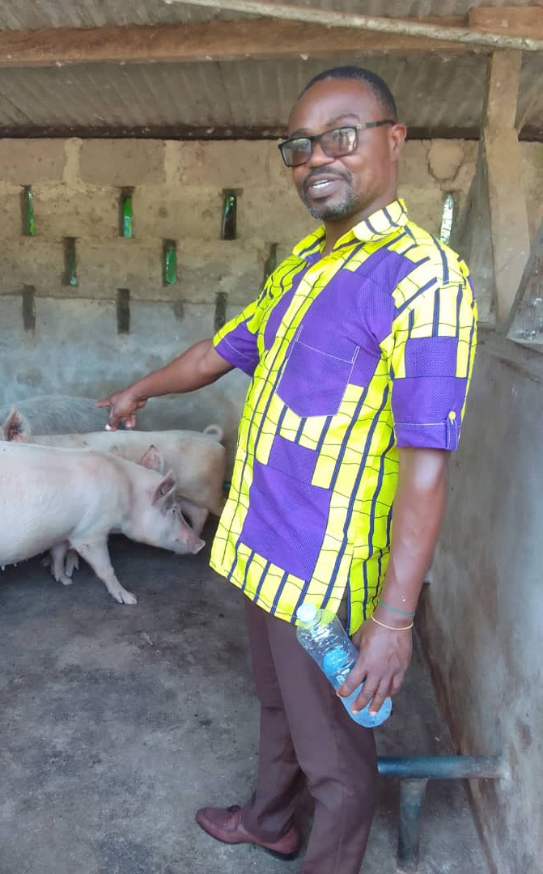
CUSTOMER PERSONA
Meet Mr. Cyrill
He is a pig farmer
Located at Haatso
He is passionate about pig production but always have a difficulty in sourcing reliable, and formulated feed for his pigs
He is looking for a reliable and formulated pig feed production company that he can always source his feed from

Slide 4

The Problem
65% of pig farmers across Ghana struggle to access and consistently obtain quality, affordable feed needed to nourish pigs, hindering their ability to run productive, scalable operations and meet the growing pork demand.

Slide 5
SOLUTION
Utilizing cassava peels along with food waste as a sustainable pig feed, which provides a cost - effective and nutritious alternative for pig nutrition.

Slide 6

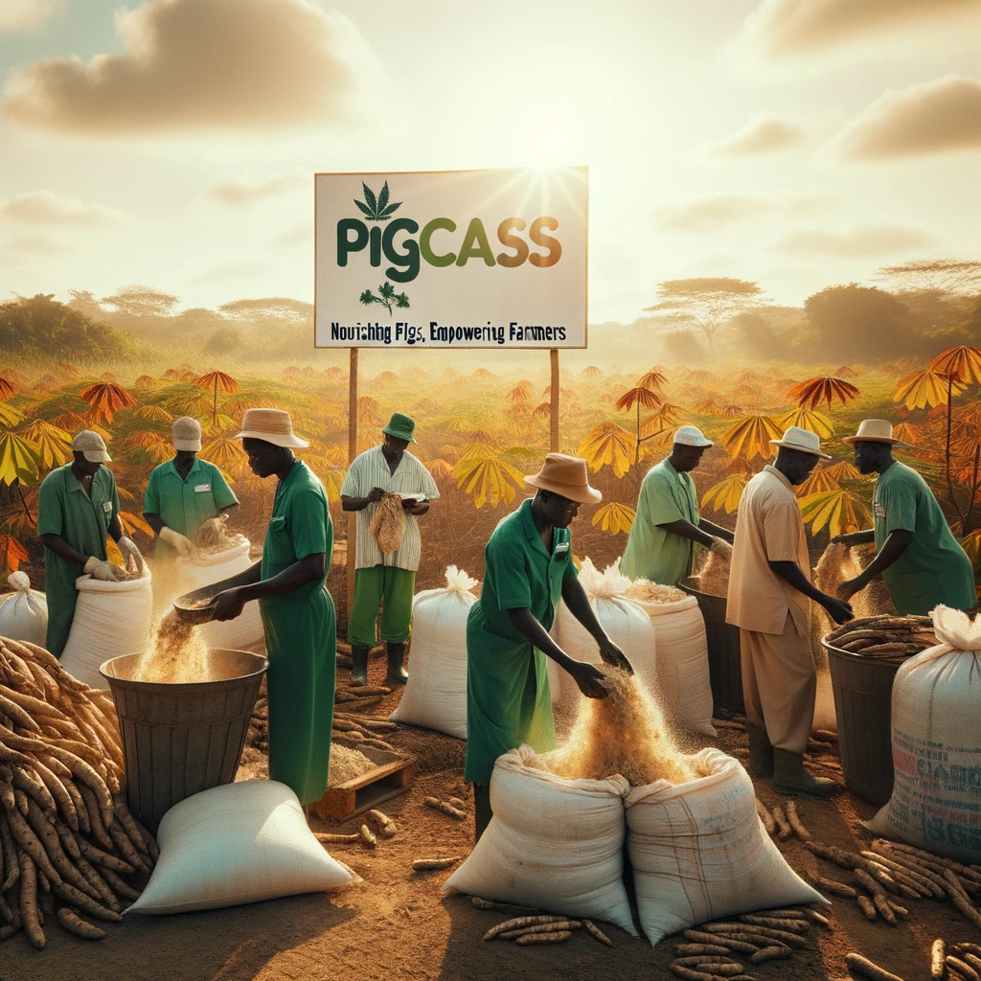
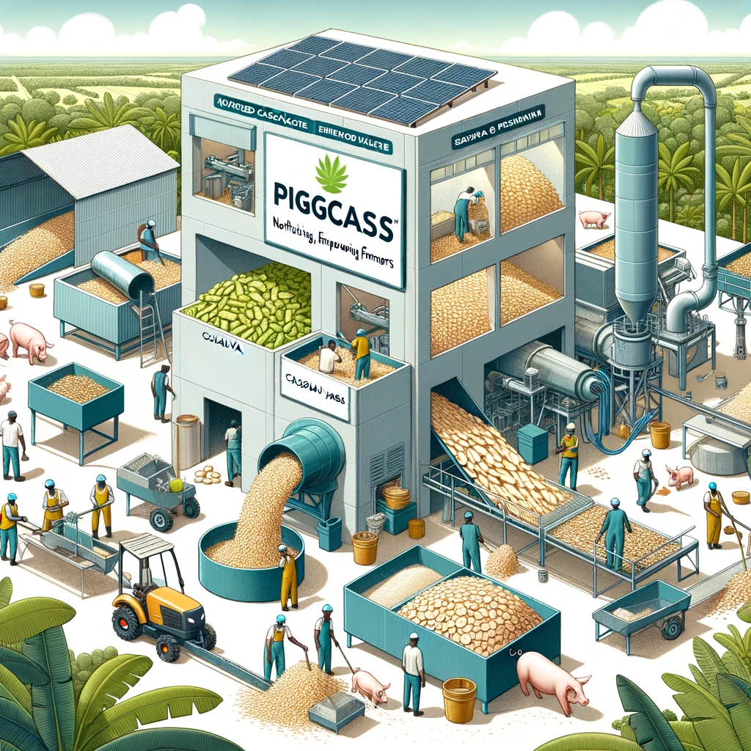
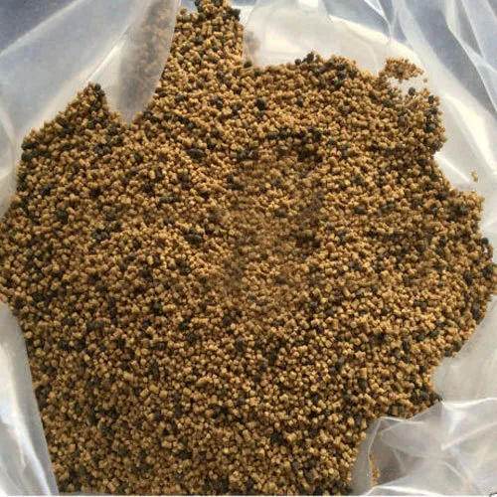
HOW IT WORKS
Custom feed formulation
Digital Marketplace
Processing and Enhancement

Slide 7
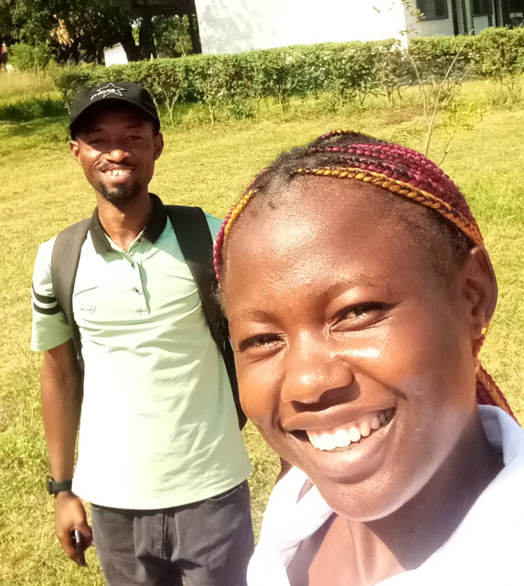
Value Proposition
1:Reduction in cost of production/feed
2:Risk and stress relief
3:healthy and quality pig production

Slide 8
COMPETITOR ANALYSIS
Competitor
Availability
Reliability
Affordability
Durability
PIGCASS
Koudijs
Aller Aqua
Ranal West Africa

Slide 9
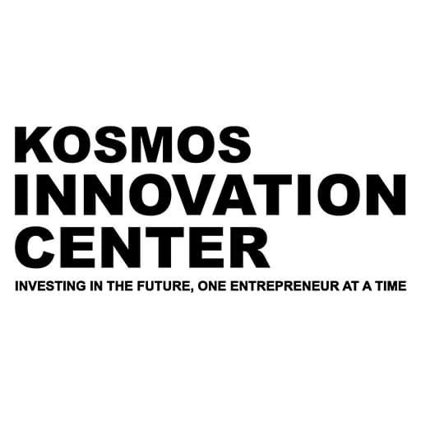





COLLABORATORS & PARTNERS

Slide 10
MARKET SIZE
Total Available Market
$14bn
Serviceable Available Market
$2.1bn
$135m
Share Of Market

Slide 11
REVENUE MODEL
Unit cost= GH₵ 155.00
Unit wholesale Price = GH₵ 230.00
Unit retail price =GH₵ 235.00
Wholesale Profit Margin: GH₵ 75.00 or 32.61%
Retail Profit Margin: GH₵ 80.00 or 34.04%
DIRECT SALES

Slide 12
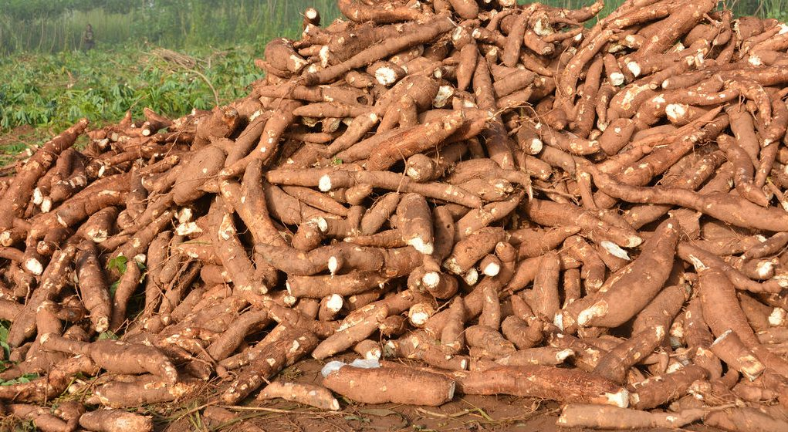
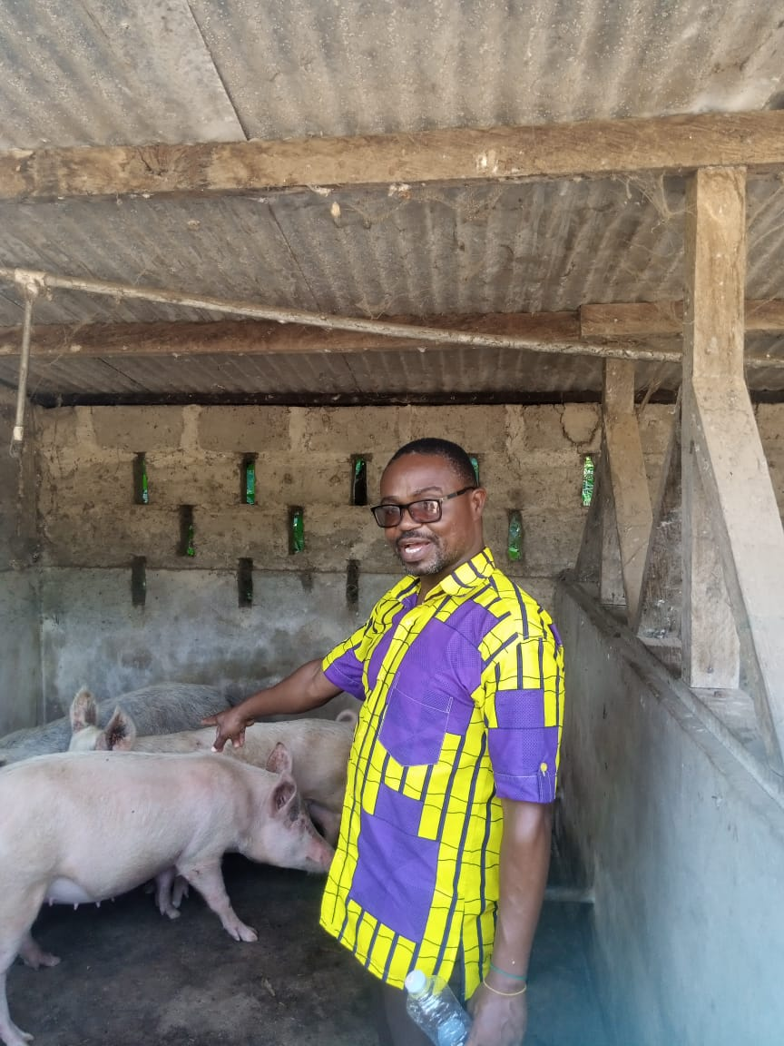
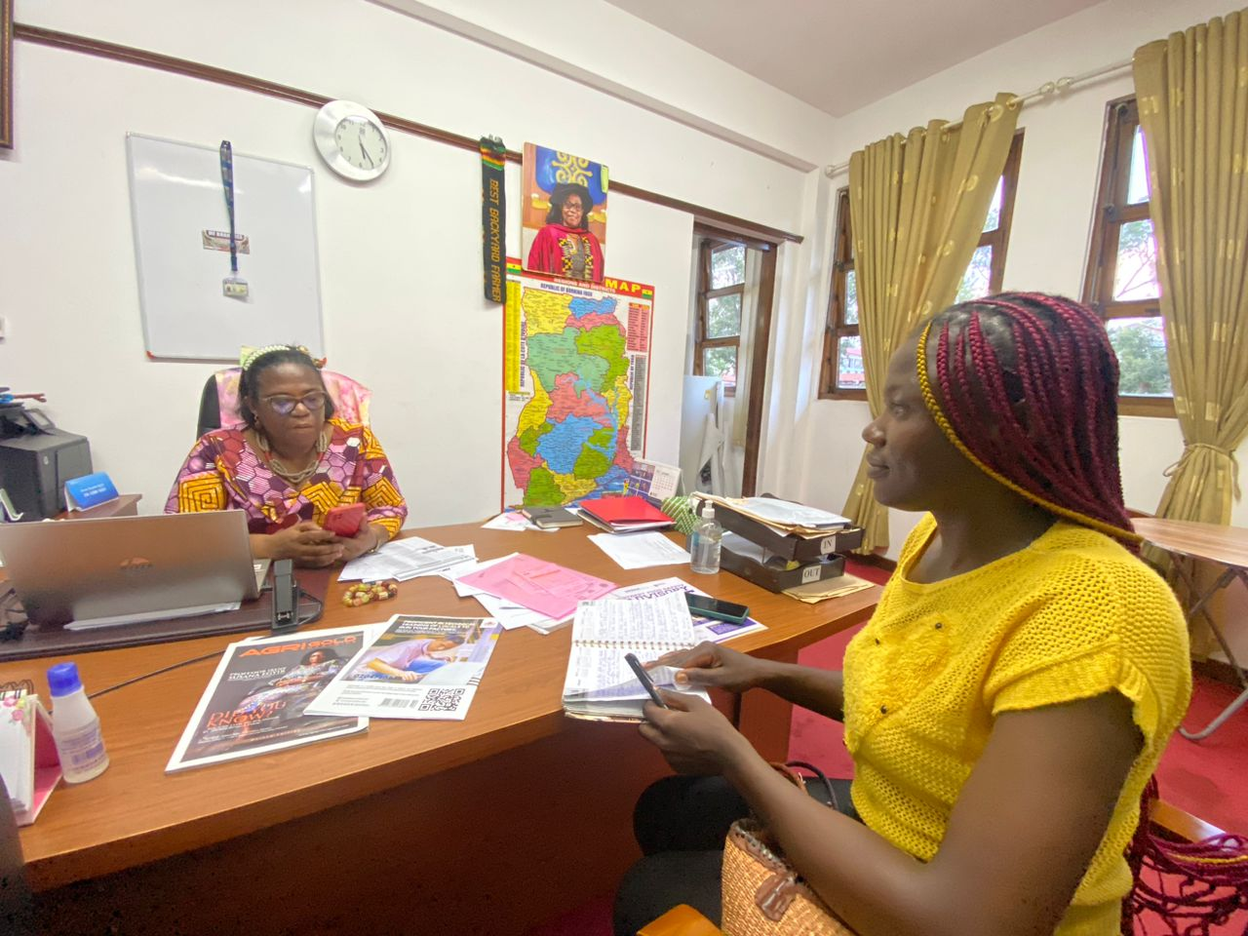
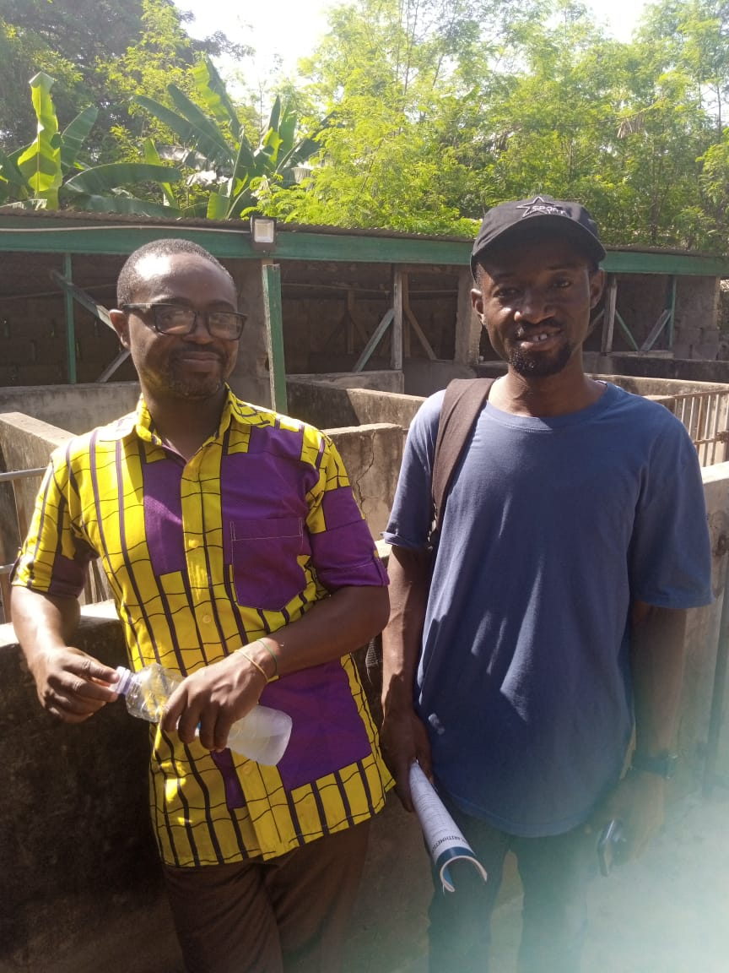
Market Research Learnings
Pig feed should be formulated towards starters, growers and finishers.
People are moving away from mutton and chevon and towards pork and chicken
Raw cassava contains cyanide which is poisonous to pick health and so cassava needs to be boilt to remove the cynide content

Slide 13




GO TO MARKET STRATEGY
Awareness
Engaging
Identify
Selling
Through local media stations and social media
Meet consumers and organizations to introduce our product and services.
Potential pig farmers and people already in the business
Product will be available at various selling points

Slide 14


Full scale production and distribution
April 2024
Feedback Loop
May 2024
Expansion and diversification
June 2024
ROADMAP
7
8
9
Brand Development and Positioning
February 2024
MVP Testing
January 2024
6
4
5
Business
registration and
FDA registration
and testing
March 2024
Preparation of product for MVP
December 2023
3
Siting of storage and processing facility
November 2023
2
1
Identification of sources of raw materials
October 2023

Slide 15



1
JOB CREATION
Creation of up to 1000 jobs across rural communities
2
IMPACT ON WOMEN
Provision of additional source of income for cassava producers especially women.
3
IMPACT ON THE ENVIRONMENT
Reduction in greenhouse emission by up to 6%

Slide 16
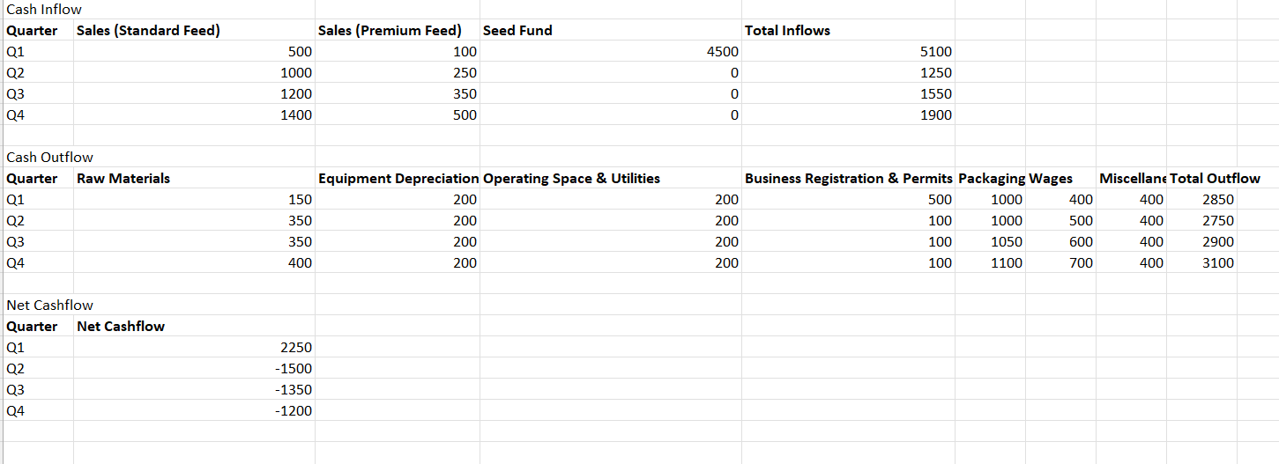
FINANCIAL PROJECTION

Slide 17

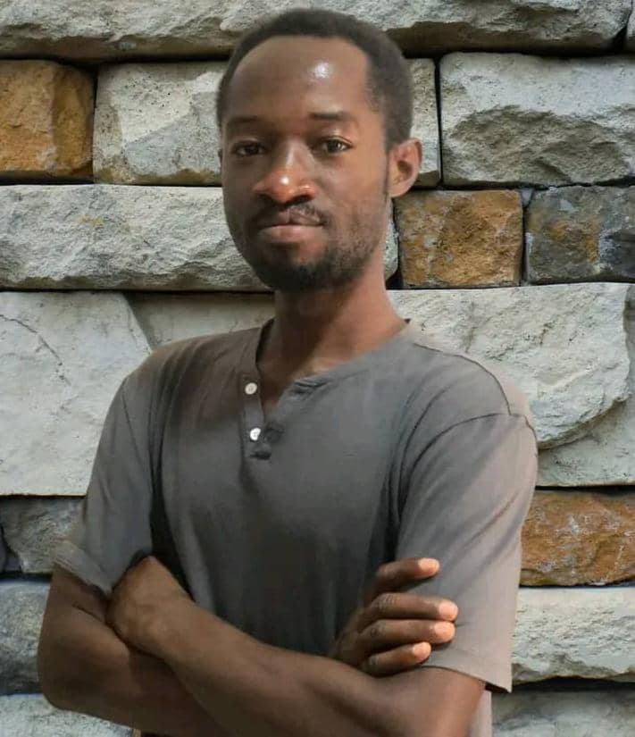
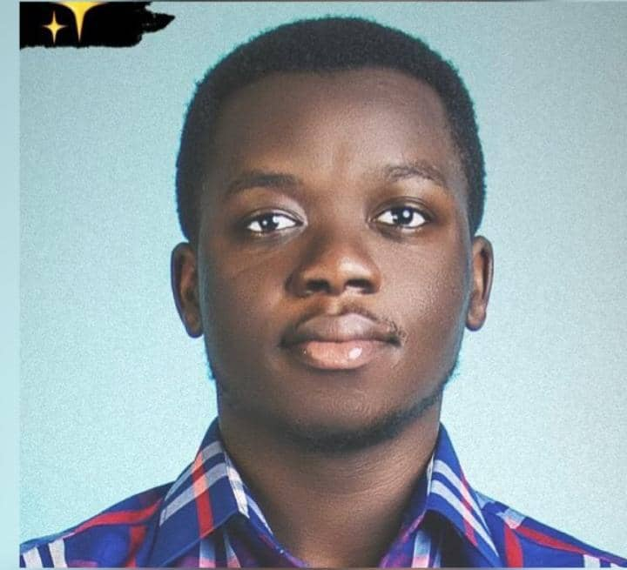
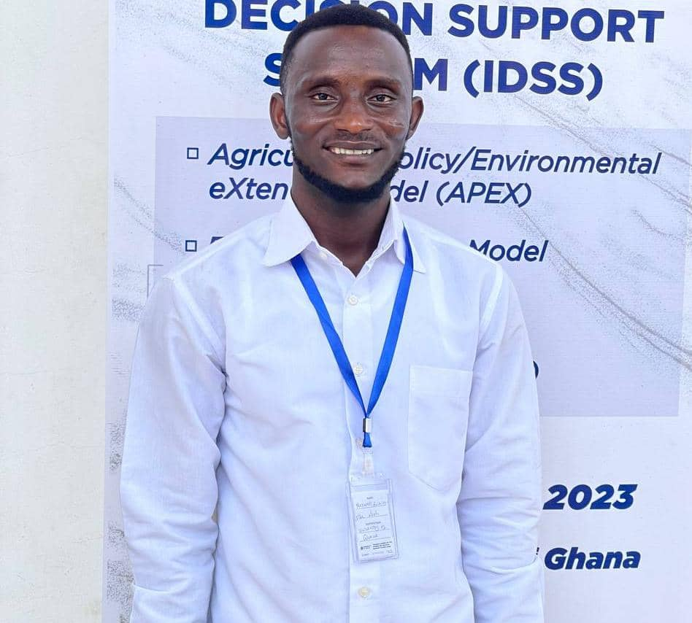
Team
Patrick Attankurugu
Maxwell Awinikagise Nsoh
Mary Awinimi Ayariga
Emmanuel Boabeng
Bsc. Public Relations
CEO
Bsc. Computer Science
CTO
Bsc.Agribusiness
CMO
Bsc. Agricultural Economics
COO

Slide 18

Thank You
Pigcass
Pigcass@gmail.com
0205867796

